Slide 1
CSSE3113 – Introduction to Software Engineering
SOFTWARE QUALITY ASSURANCE

Slide 2
Software quality assurance vs. Software quality control
Quality Control (QC) is a set of activities designed to evaluate the quality of developed or manufactured product(IEEE,1991)
Activities whose main objective is the withholding of any product that does not qualify.
Quality Assurance (QA) is meant to minimize the costs of quality by introducing a variety of activities throughout the development process and maintenance process in order to prevent the causes of errors, detects them, and corrects them in the early stages of the development.

Slide 3
Software errors, faults and failures
Software errors:
Sections of the code that are partially or totally incorrect as a result of a grammatical, logical or other mistake made by a systems analyst, a programmer, or another member of the software development team.
Software faults
are software errors that cause the incorrect functioning of the software in general or in specific application.
Software faults become software failures only when they are “activated”, that is, when a user tries to apply the specific software section that is faulty. Thus, the root of any software failure is a Software error.
Do all software faults end with software failures?

Slide 4
Software Defect Origins
Client–developer communication failures
  Misunderstanding of the
  Client’s instructions as stated in the requirement document
  Client’s requirements changes presented to the developer
  Client’s responses to the design problems presented by the developer.
  Lack of attention to client messages referring to requirements changes
Deviations from software requirements
  Developers may deliberately deviate from the documented requirements
  The developer reuses software modules taken from an earlier project without sufficient analysis of the changes
  Due to time or budget pressures, the developer decides to omit part of the required functions

Slide 5
Software Defect Origins
Logical design errors
  Algorithm mistakes
  Non-compliance with documentation and coding standard
Shortcomings of testing process
  Incomplete test plans leave untreated portions of the software
  Incomplete correction of detected errors due to negligence or time pressures.
Documentation Errors
  Errors in design document
    Omission of software functions.
  Errors in user manual
    Errors in the explanations and instructions given to users

Slide 6
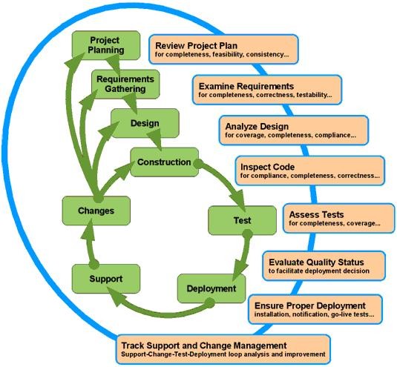
SQA – Software Life Cycle

Slide 7
Quality Standards
Quality standards for software engineering:
These are standard written down, that must be followed by software engineers and engineering firms to achieve quality in their products. Below are some major standards in the software engineering industry:
1. Capability Maturity Model (CMM):
written by the software engineering institute, this model describes good practices for planning, engineering and managing software development. This practice allows software engineering organizations to create quality software while minimizing budget and time factors. CMM allows software engineers to judge and compare its processes to stated practices in the industry. Thus improving software processes and quality.

Slide 8
CMMI Staged Representation - 5 Maturity Levels
Level 5
Process performance continually improved through incremental and innovative technological improvements.
Optimizing
Level 4
Quantitatively
Managed
Processes are controlled using statistical and other quantitative techniques.
Process Maturity
Level 3
Defined
Processes are well characterized and understood. Processes, standards, procedures, tools, etc. are defined at the organizational level.
Level 2
Managed
Processes are planned, documented, performed, monitored, and controlled at the project level.
Level 1
Initial
Processes are unpredictable, poorly controlled.

Slide 9
Quality Standards
2. ISO 9000 family: These are standards for quality management and quality assurance for any business. It applies to process of creating, and controlling of products and services an organization provides, by giving an organized course for activities to be carried out to ensure that customer’s requirements are made (ISOQAR, 2010). This includes the:
ISO 9000
ISO 9001
ISO 9126

Slide 10
Quality Standards
3. IEEE STD 1061-1998 Standard:
This standard was created as a way to establish quality requirements, and provides a well defined metrics for identifying, implementing, analyzing and validating the processes of developing a quality software product. The standard provides metrics for quality for the entire software engineering life cycle (IEEE Std 1061, 1998).

Slide 11
Software Quality Assurance and Reviews
Software development Process → Different documents (SRS+ DDS)
The system analysts & development team members who prepared the document will check it repeatedly→ in order to detect any possible error that might have entered.
Others – such as peers, experts, and customer’s representatives– reviewing the product and detecting the errors unnoticed by the development team.

Slide 12
Review Methodologies
Several methodologies can be implemented when reviewing documents.
  Formal Reviews
  Peer Reviews (inspections and walkthroughs)
  Expert opinions

Slide 13
Review Methods –Formal reviews
Formal reviews, variously called …“formal technical reviews (FTR)”
Necessary for approval of the product.
Formal reviews may be conducted at any development milestone→ completion of document, whether that document is a requirement specification , Design document or an installation plan.

Slide 14
Peer Reviews:
Inspections / Walkthroughs
Walkthroughs and inspection differ in formality
  Inspection the more formal of the two
Inspections emphasize the objective of corrective action
Walkthroughs limited to comments on document reviewed.
Inspections are considered to contribute more to SQA.

Slide 15
The Peer Review Session
In inspection
Presenter reads a section of the document.
As the session progresses, Participants either deliver their comments to the document or address their reactions to the comments.
Restrict discussion to identification of errors.
Presenter in walkthrough provides an overview
Walkthrough Scribe records each error (location, description, type and character (incorrect, missing parts, extra parts etc).
Inspection scribe will add estimated severity of each defect and the formulation of preventive / corrective actions.

Slide 16
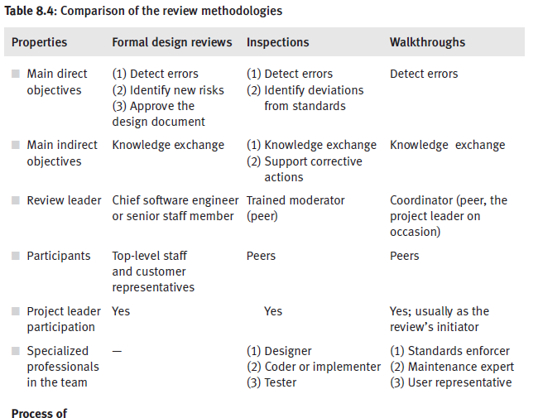
Comparison of review methodologies

Slide 17
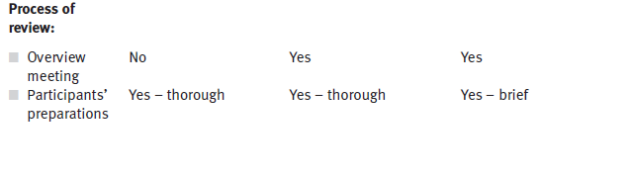
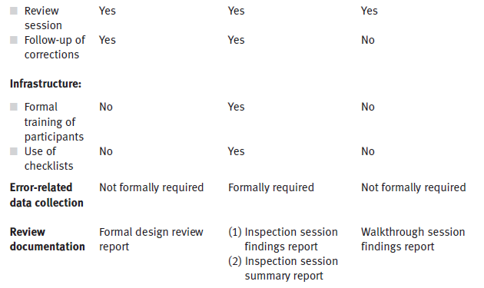
Comparison of review methodologies

Slide 18
Expert Opinions
Expert opinions support quality assessment efforts by introducing additional external capabilities into the organization's in-house development process
Turning to outside experts may be particularly useful in the following situations:
    – Insufficient in-house professional capabilities in a given area
    – In small organizations: difficult to find enough suitable candidates to participate in the design review teams
    – In small organizations: extreme work pressures, an outside expert’s opinion can replace an inspection process
    – Temporary inaccessibility of in-house professional
    – In cases of major disagreement among the organization's senior professional, an outside expert may support a decision

